Slide 1


Snake Game: A Fascinating Journey into Web Development
Embark on an interactive adventure as we explore the mesmerizing world of the Snake Game and its fascinating role in web development.
by SarathChandra

Slide 2

Introduction
Discover the origins of the Snake Game and its evolution into a beloved classic. Unleash your nostalgia as we dive into its captivating simplicity and addictive gameplay.

Slide 3
Working of the Snake Game
Delve into the intricacies of the Snake Game's mechanics. Unravel the logic and algorithms behind its movement, collision detection, and scoreboard management.

Slide 4

Uses of the Snake Game
Recreation
Education
Experience endless entertainment as the Snake Game provides hours of fun and relaxation, both as a casual pastime and intense competition.
Introduce programming concepts through playful learning. The Snake Game empowers beginners to understand logic, algorithms, and game development principles.
Stress Relief
Elevate your mood and alleviate stress by immersing yourself in the engaging challenges offered by the Snake Game's simultaneous simplicity and complexity.

Slide 5
Advantages of the Snake Game
Accessible
Timeless Entertainment
Cognitive Benefits
The Snake Game can be enjoyed on various devices, including smartphones, computers, and gaming consoles, making it accessible to a broad audience.
Enhance your concentration, reflexes, and critical thinking skills while navigating the Snake Game's challenging levels and strategic decision-making.
With its straightforward gameplay and addictive nature, the Snake Game transcends generations, providing timeless entertainment to players of all ages.

Slide 6

Disadvantages of the Snake Game
1
Time Sink
2
Sedentary Activity
Beware of the Snake Game's ability to captivate your attention for extended periods, potentially causing productivity distractions.
Due to its immersive nature, the Snake Game may discourage physical activity and promote a sedentary lifestyle if not balanced with exercise.
3
Limited Complexity
Although captivating, the simplicity of the Snake Game may limit its appeal to those seeking more intricate and graphically advanced gaming experiences.

Slide 7

Future Scope of the Snake Game
1
Advanced Graphics
Immerse yourself in stunning visuals and rich gameplay experiences as advancements in technology propel the Snake Game's visual appeal.
2
Multiplayer Integration
Connect with friends and gamers worldwide as the Snake Game embraces multiplayer functionality, fostering fierce competition and camaraderie.
3
Virtual Reality
Step into a digital realm like never before, as the Snake Game leverages Virtual Reality to provide a truly immersive and captivating gameplay experience.

Slide 8
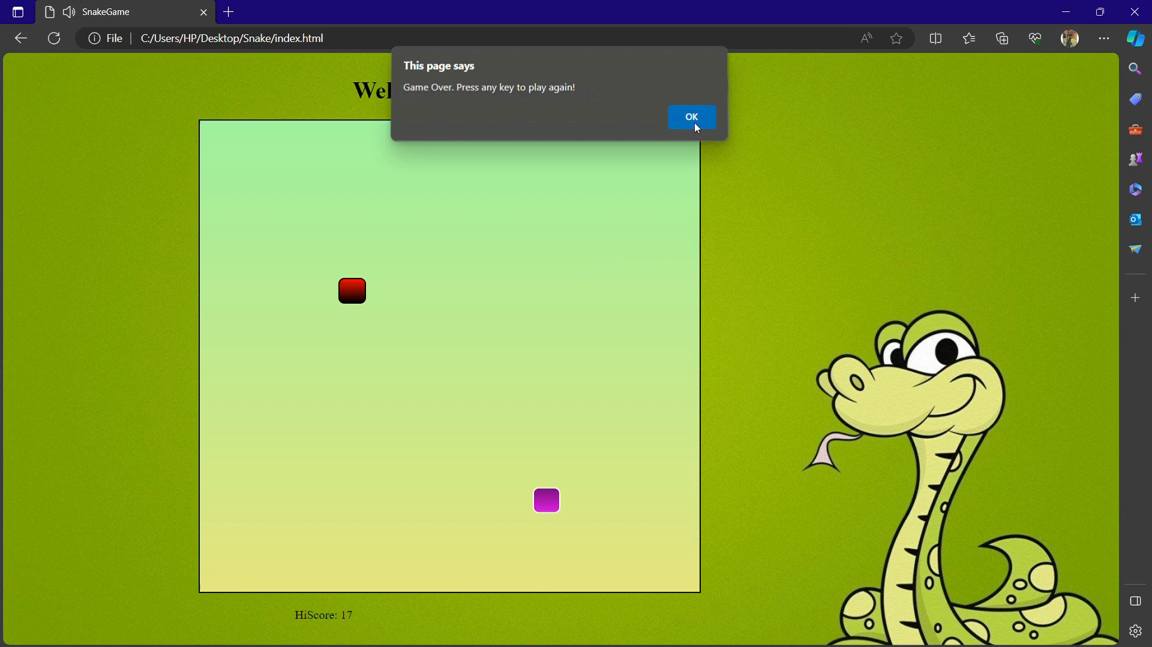
OUTPUT OF THE PROJECT WILL BE as:

Slide 9




